Slide 1
Message Authentication Algorithms

Slide 2
Contents
MD5 Message Digest Algorithm
  Logic
  Compression Function
Secure hash Algorithm
  Logic
  Compression Function
RIPEMD-160
  Logic
  Compression Function
  Design Decision
HMAC
  Design Objectives
  Algorithm
  Security of HMAC

Slide 3
What is Authentication?
Dictionary:
The verification of the identity of a person or
process. In a communication system, authentication verifies that messages really come from their stated source, like the signature on a (paper) letter.
Network Security:
Process of validating identity of user
Process of validating the integrity of data

Slide 4
Authentication
Three technologies that provide different kinds of authentication:
Message Digests
Digital Signatures
Certificates

Slide 5
What is a hash function?
A hash function H is a transformation that takes an input m and returns a fixed-size string, which is called the hash value h (that is, h = H(m)).
Hash functions with just this property have a variety of general computational uses, but when employed in cryptography, the hash functions are usually chosen to have some additional properties.

Slide 6
Requirements for Cryptographic Hash Functions
The basic requirements for a cryptographic hash function are as follows.
  The input can be of any length.
  The output has a fixed length.
  H(x) is relatively easy to compute for any given x.
  H(x) is one-way.
  H(x) is collision-free.

Slide 7
H(x) is one-way ...
A hash function H is said to be one-way if it is hard to invert, where ``hard to invert'' means that given a hash value h, it is computationally infeasible to find some input x such that H(x) = h.

Slide 8
Compression Function
Damgard and Merkle greatly influenced cryptographic hash function design by defining a hash function in terms of what is called a compression function.
A compression function takes a fixed-length input and returns a shorter, fixed-length output.
Given a compression function, a hash function can be defined by repeated applications of the compression function until the entire message has been processed.

Slide 9
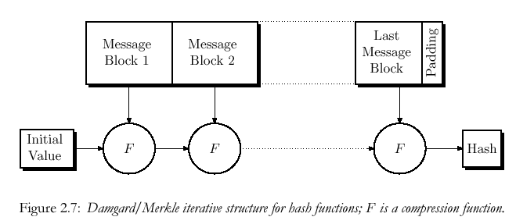
Compression Function
A message of arbitrary length is broken into blocks whose length depends on the compression function, and “padded” so the size of the message is a multiple of the block size. The blocks are then processed sequentially, taking as input the result of the hash so far and the current message block, with the final output being the hash value for the message.

Slide 10
Message Digest MD5

Slide 11
Message Digest Algorithm 5(MD5)
Input and Output
  Input : arbitrary length
  Output : 128 bit
  Processing : 512 bit(16 word)
  Store : little-endian Format
Processing Sequence
  1. Append padding bits
  2. Append length
  3. Initialize MD buffer
  4. Process message in 512-bit blocks
  5. Output

Slide 12
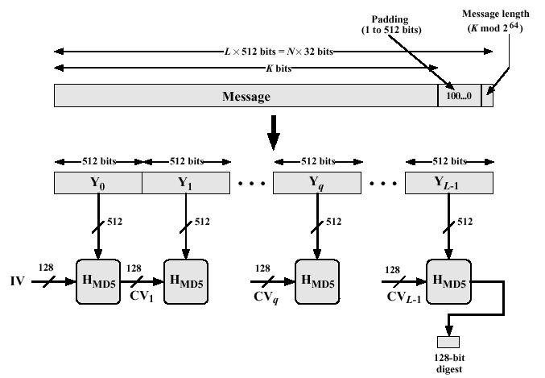
Message Digest Generation

Slide 13
Step 1. Append Padding Bits
The message is "padded" (extended) so that its length (in bits) is congruent to 448, modulo 512. That is, the message is extended so that it is just 64 bits shy of being a multiple of 512 bits long. Padding is always performed, even if the length of the message is already congruent to 448, modulo 512.
Padding is performed as follows: a single "1" bit is appended to the message, and then "0" bits are appended so that the length in bits of the padded message becomes congruent to 448, modulo 512. In all, at least one bit and at most 512 bits are appended.

Slide 14
Step 2. Append Length
A 64-bit representation
The length of the message before the padding bits were added is appended to the result of the previous step.
In the unlikely event that the length is greater than 2^64, then only the low-order 64 bits are used.

Slide 15

Step 3. Initialize MD Buffer
A four-word buffer (A,B,C,D) is used to compute the message digest.
Here each of A, B, C, D is a 32-bit register.
These registers are initialized to the following values in hexadecimal.

Slide 16
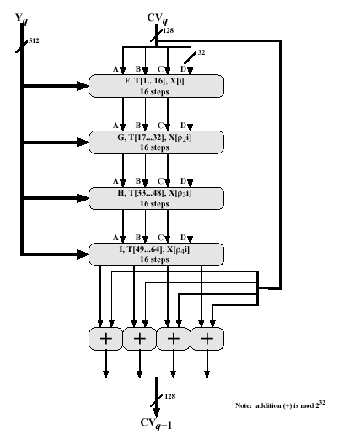
Step 4.
(4 Rounds)
Input
  512-bit Message
  Chaining Value(Initial Value)
output
  128-bit Chaining value
Initialize (Little endian-low order bytes first)
  A : 67452301 (01234567)
  B : EFCDAB89 (89ABCDEF)
  C : 98BADCFE (FEDCBA98)
  D : 10325476 (76543210)

Slide 17
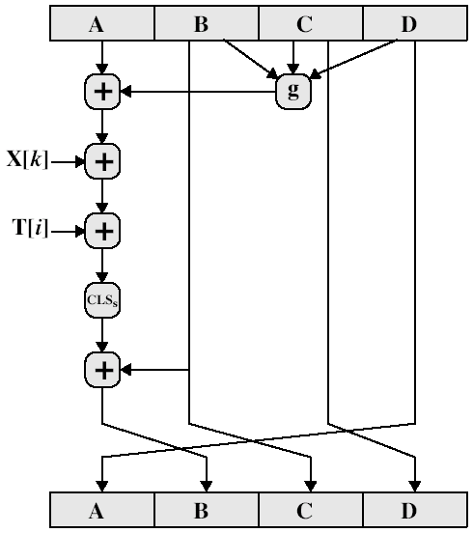
MD5 Single Step
g : primitive function
X[k] : kth 32bit in Message
  Where 0<= k<=15
T[i] : Additive Constant
CLS_{s} : Circular Left Shift by s
+ : addition modulo 2³²

Slide 18
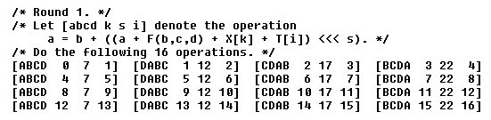
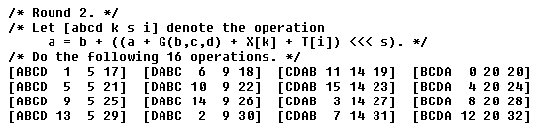
Step 4. Round 1 and 2

Slide 19
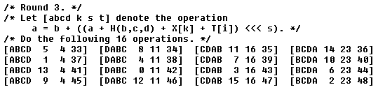
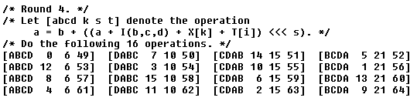
Step 4. Round 3 and 4

Slide 20
Primitive Function in MD5
Function Summarize
Round | Primitive Function g | g(b,c,d)
1 | F(b,c,d) | (b^c)v(b´^d)
2 | G(b,c,d) | (b^d)v(c^d´)
3 | H(b,c,d) | b ⊕ c ⊕ d
4 | I(b,c,d) | c ⊕ ( b v d´)
Truth Table
b c d | F G H I | b c d | F G H I
0 0 0 | 0 0 0 1 | 1 0 0 | 0 0 1 1
0 0 1 | 1 0 1 0 | 1 0 1 | 0 1 0 1
0 1 0 | 0 1 1 0 | 1 1 0 | 1 1 0 0
0 1 1 | 1 0 0 1 | 1 1 1 | 1 1 1 0

Slide 21
Table T, constructed from the sine function
This step uses a 64-element table T[1 ... 64] constructed from the sine function. Let T[i] denote the i-th element of the table, which is equal to the integer part of 4294967296 times abs(sin(i)), where i is in radians. The elements of the table are given in the following slide.

Slide 22
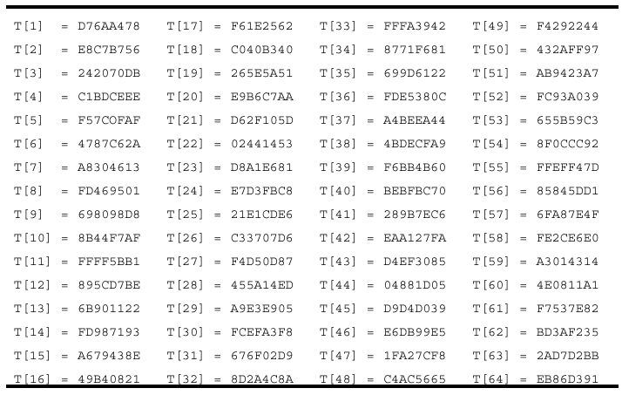
Table T, constructed from the sine function

Slide 23
MD5 Hashing
MD5("The quick brown fox jumps over the lazy dog") = 9e107d9d372bb6826bd81d3542a419d6
MD5("The quick brown fox jumps over the lazy cog") = 1055d3e698d289f2af8663725127bd4b
MD5("") = d41d8cd98f00b204e9800998ecf8427e

Slide 24
Secure Hash Algorithm - SHA

Slide 25
SHA
SHA originally designed by NIST & NSA in 1993
was revised in 1995 as SHA-1
NIST issued revision in 2002 adds 3 additional versions of SHA
  SHA-256, SHA-384, SHA-512
structure & detail is similar to SHA-1
based on design of MD4 with key differences

Slide 26
SHA-512
Background:
  Based on Merkle-Damgard scheme, Rivest MD5
  NIST standard
Ideas:
  Large number of rounds (80) for maximum confusion
  Heavy use of non-invertible functions
    Combinations of rotation and XOR
    Condition and majority functions
  Appearance of “randomness” in initial vector
Designed for efficiency
  All operations are very fast in hardware

Slide 27
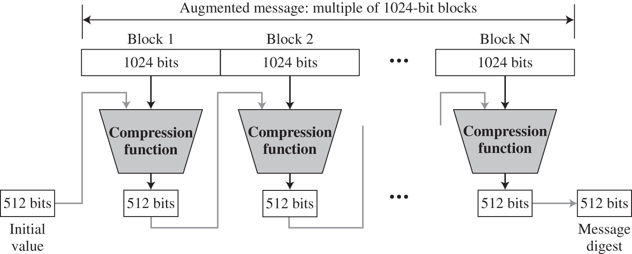
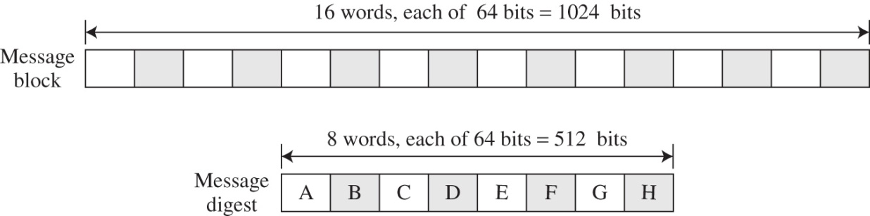
SHA-512
512 bit message digest (secure against attack)
  Block size: 1024 bits
  Digest broken down into 64 bit “words” called A – H

Slide 28
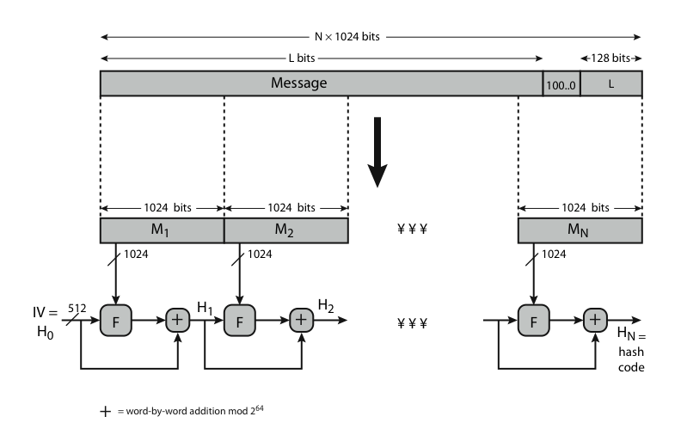
SHA-512
Notes:
Now examine the structure of SHA-512, noting that the other versions are quite similar.
SHA-512 follows the structure depicted in Stallings Figure 12.1. The processing consists of the following steps:
• Step 1: Append padding bits
• Step 2: Append length
• Step 3: Initialize hash buffer
• Step 4: Process the message in 1024-bit (128-word) blocks, which forms the heart of the algorithm
• Step 5: Output the final state value as the resulting hash
See text for details.

Slide 29
STEP: 1 & 2
Append Padding bits. Length = 896 (mod 1024) (padding bits 1-1024, added even if it doesn’t need padding)
Append Length. A block of 128 bits … length before padding. (message then multiple of 1024)

Slide 30
STEP 3: Initialize Hash Buffers
512 bit buffer holds intermediate and final results.
Buffer represented as 8 – 64 bit registers.
Values are store in big-endian format (most significant byte (left most) first).
Values obtain by taking the first 64 bits of the fractional parts of the square roots of the first 8 primes.

Slide 31

SHA-512 Initial Digest
Initial values of message digest H₀
Designed for appearance of “randomness”
  Created from first 8 primes (2, 3, 5, 7, 11, 13, 17, 19)
  Take square root
  Take first 64 digits of fractional part
A | 6A09E667F3BCC908
B | BB67AE8584CAA73B
C | 3C6EF372EF94F828
D | A54FE53A5F1D36F1
E | 510E527FADE682D1
F | 9B05688C2B3E6C1F
G | 1F83D9ABFB41BD6B
H | 5BE0CD19137E2179

Slide 32
STEP 4: The Algorithm
processing message in 1024-bit blocks
consists of 80 rounds
  updating a 512-bit buffer
  using a 64-bit value Wt derived from the current message block. The message block is of 1024 bits or 16 word it is expanded to 80 words one for each round using an expansion function.
  a round constant based on cube root of first 80 prime numbers.
Notes:
The SHA-512 Compression Function is the heart of the algorithm. In this Step 4, it processes the message in 1024-bit (128-word) blocks, using a module that consists of 80 rounds, labeled F in Stallings Figure 12, as shown in Figure 12.2. Each round takes as input the 512-bit buffer value, and updates the contents of the buffer. Each round t makes use of a 64-bit value Wt derived using a message schedule from the current 1024-bit block being processed. Each round also makes use of an additive constant Kt, based on the fractional parts of the cube roots of the first eighty prime numbers. The output of the eightieth round is added to the input to the first round to produce the final hash value for this message block, which forms the input to the next iteration of this compression function, as shown on the previous slide.

Slide 33
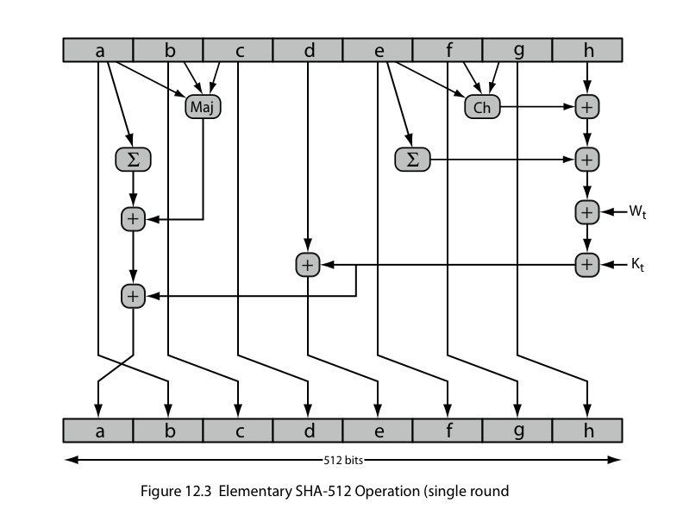
SHA-512 Round Function
Notes:
The structure of each of the 80 rounds is shown in Stallings Figure 12.3. Each 64-bit word shuffled along one place, and in some cases manipulated using a series of simple logical functions (ANDs, NOTs, ORs, XORs, ROTates), in order to provide the avalanche & completeness properties of the hash function. The elements are:
Ch(e,f,g) = (e AND f) XOR (NOT e AND g)
Maj(a,b,c) = (a AND b) XOR (a AND c) XOR (b AND c)
∑(a) = ROTR(a,28) XOR ROTR(a,34) XOR ROTR(a,39)
∑(e) = ROTR(e,14) XOR ROTR(e,18) XOR ROTR(e,41)
+ = addition modulo 2^64
Kt = a 64-bit additive constant
Wt = a 64-bit word derived from the current 512-bit input block.

Slide 34
Round Function
Each 64-bit word shuffled along one place, and in some cases manipulated using a series of simple logical functions (ANDs, NOTs, ORs, XORs, ROTates), in order to provide the avalanche & completeness properties of the hash function. The elements are:
Ch(e,f,g) = (e AND f) XOR (NOT e AND g)
Maj(a,b,c) = (a AND b) XOR (a AND c) XOR (b AND c)
∑(a) = ROTR(a,28) XOR ROTR(a,34) XOR ROTR(a,39)
∑(e) = ROTR(e,14) XOR ROTR(e,18) XOR ROTR(e,41)
+ = addition modulo 2^64
Kt = a 64-bit additive constant based on cube root of first 80 prime numbers.
Wt = a 64-bit word derived from the current 512-bit input block.

Slide 35
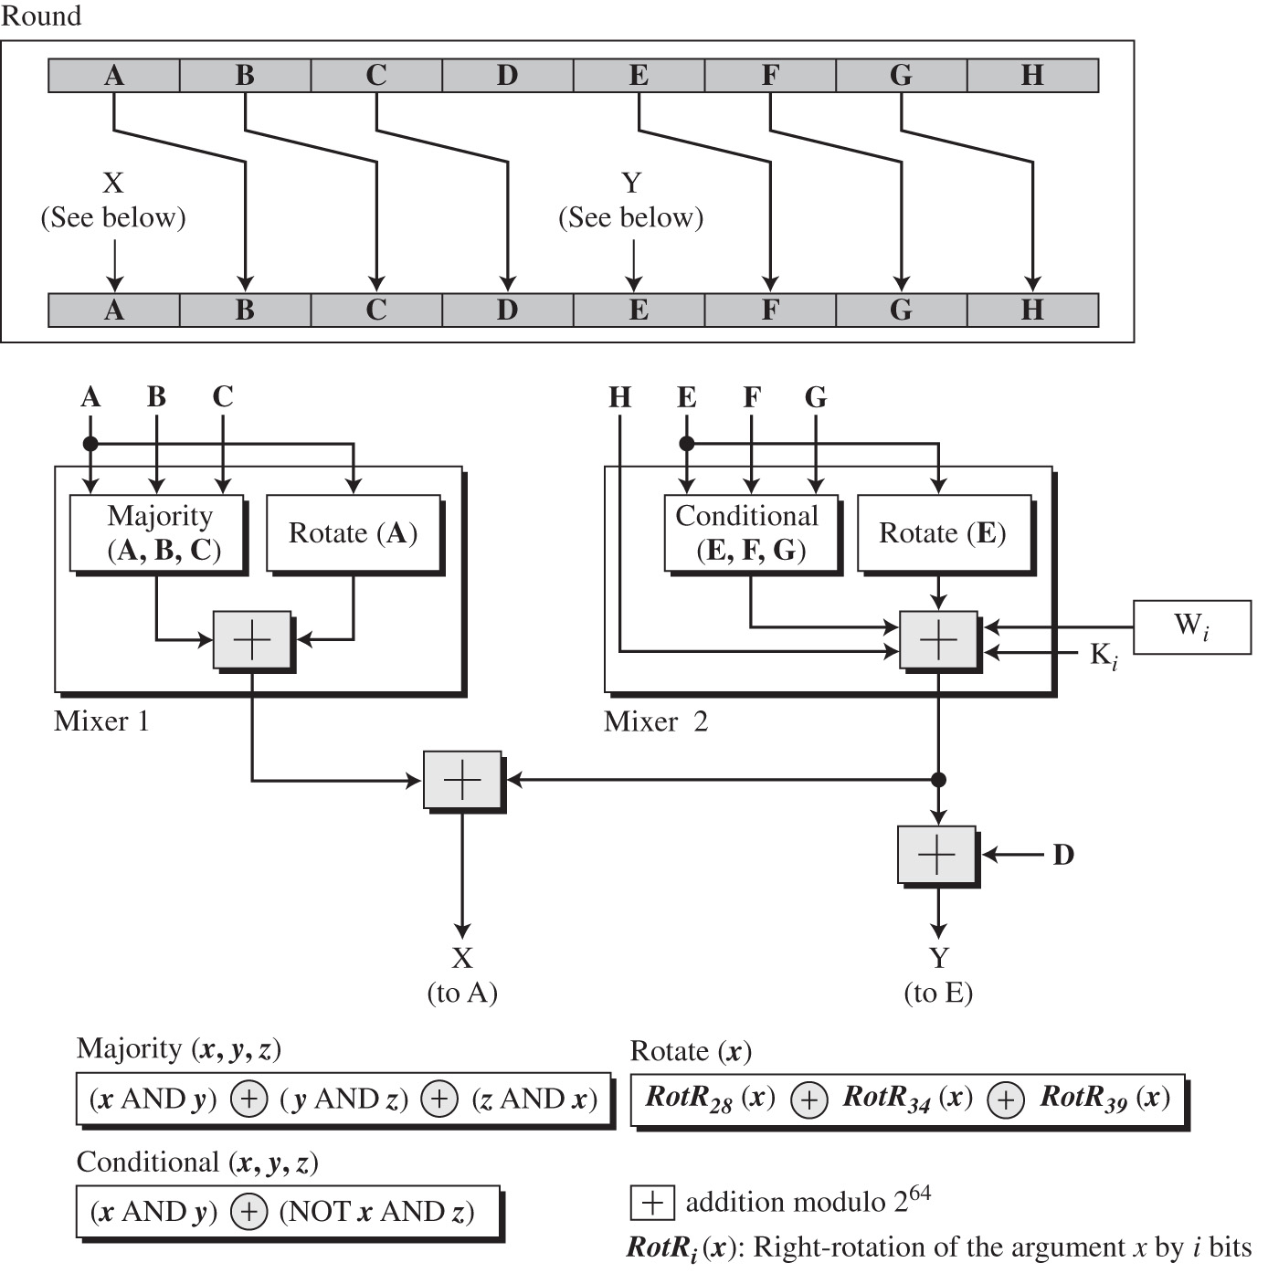
SHA-512 Round Structure
Blocks A – C and E – G shifted over one
  No real effect, other than to make sure every block affected by more complex operations

Slide 36
SHA-512 Round Structure
New blocks A and E created as function of:
  All previous blocks A – G
  Round word W_{i} and round key K_{i} using addition mod 2⁶⁴

Slide 37
SHA-512 Rotation Function
Next value of A, E based on previous value
Rotate right by 28, 34, and 39 bits
Combine with XOR to mix up bits

Slide 38
Majority Function
Majority function of (A, B, C):
  Ith bit of result = 1 if at least 2 of i^{th} bits of A, B, C = 1
  0 otherwise
  Example: A = 11001010
  B = 01101001
  C = 10011101
  majority = 11001001
  Idea: No way to reconstruct
  A, B, C from majority

Slide 39
Conditional Function
Conditional function of (E, F, G):
  Ith bit of result = i^{th} bit of F if i^{th} bit of E = 1
  = i^{th} bit of G otherwise
  Like “If E then F else G”
  Example: E = 11001010
  F = 01101001
  G = 10011101
  Conditional = 01011101
  Idea: No way to reconstruct
  E, F, G from conditional

Slide 40
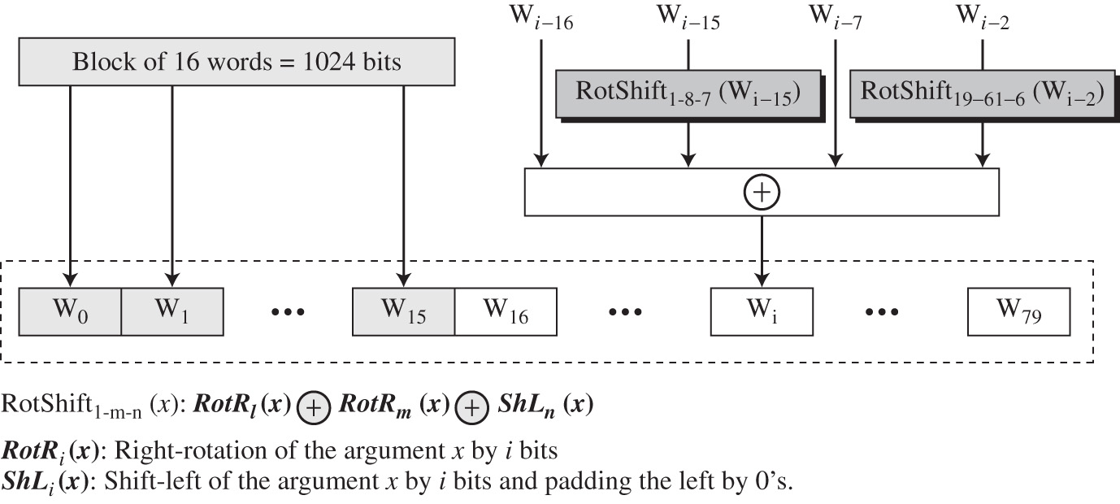
Word Expansion in SHA-512
Block of 16 words expanded to 80 words
  Used by 80-round compression function

Slide 41
Word Expansion in SHA-512
Each word function of previous 4 words
  Combined with XOR
  Confusion added with rotation and shifting
  (not invertible)
Right rotation i bits
→ | → | → | → | → | → | → | →
RotShift i-j-k
Right rotation j bits
⊕
→ | → | → | → | → | → | → | →
Left shift k bits
(adding 0’s to end)
← | ← | ← | 0 | 0 | 0 | 0 | 0

